Slide 1


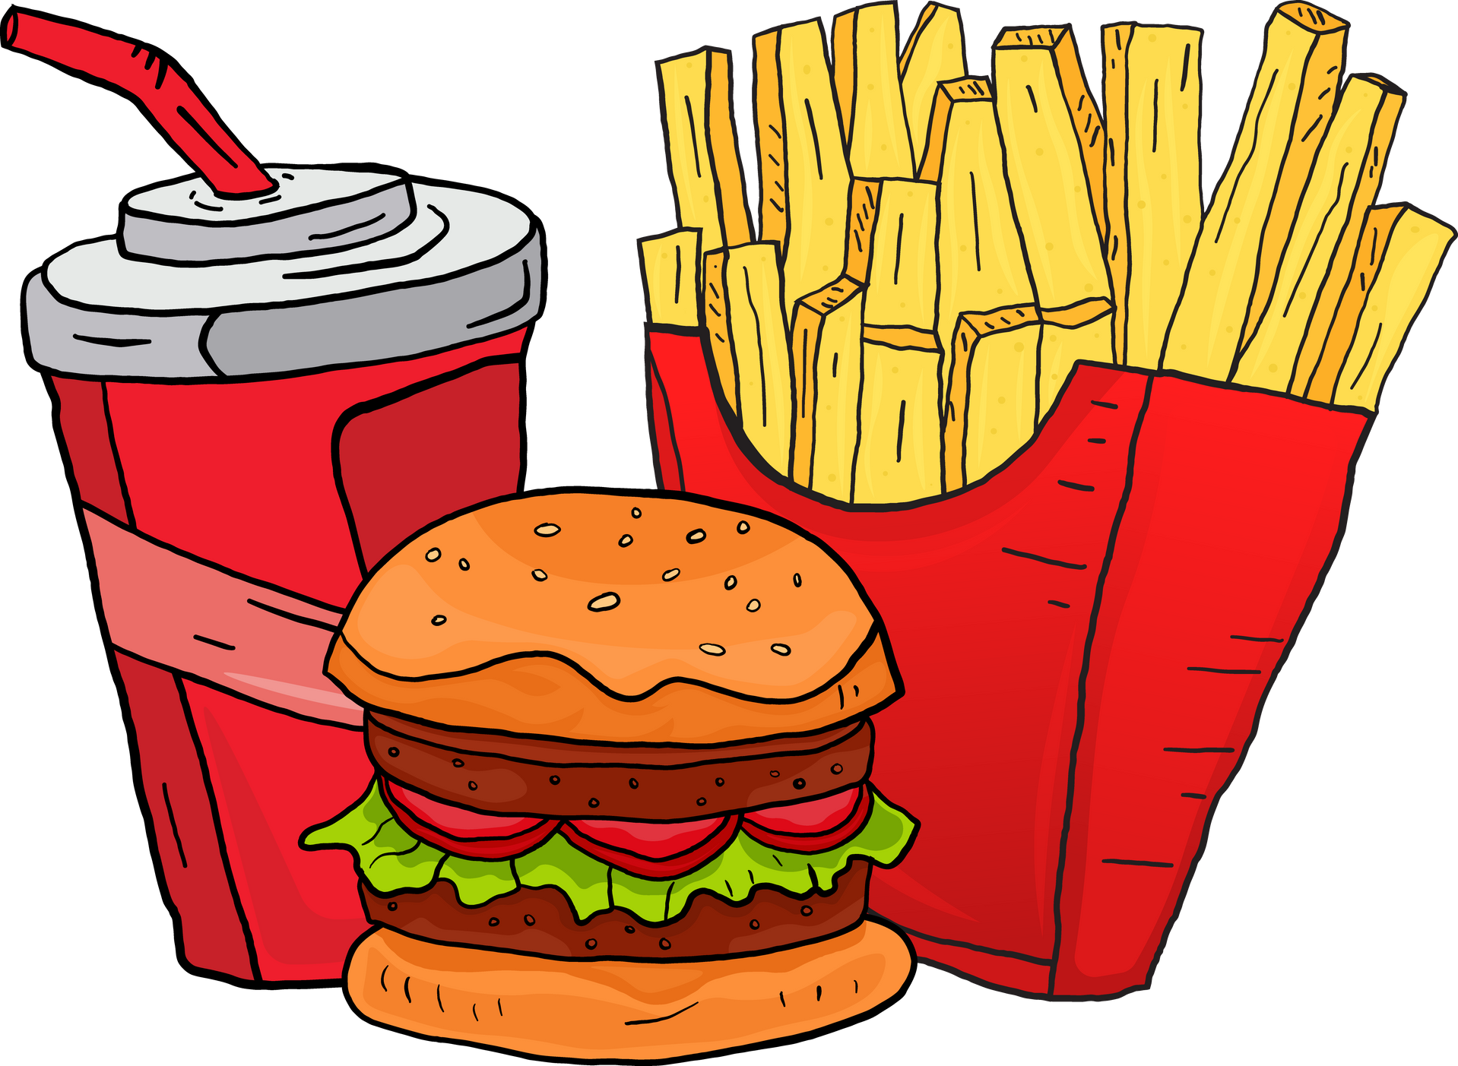



SQL Project
By
Suraj Maurya
Swiggy Restaurants Data Analysis
surajmaurya2
surajmaurya1

Slide 2



Project Aim
The aim of this project is to analyse Swiggy's restaurant data using MySQL to extract meaningful insights about customer preferences, restaurant performance, and delivery trends. This analysis will help identify patterns in cuisine popularity, pricing strategies, and delivery efficiencies, enabling data-driven decision-making to optimize restaurant operations, enhance customer satisfaction, and drive business growth.

Slide 3
Dataset Preparation and Enhancement
The dataset for this project was sourced from Kaggle, containing information about restaurants, cuisines, ratings, and related attributes. However, the original dataset did not include an orders table, which was essential for analyzing order trends and popular dishes.
To address this, I created a custom table to simulate order-related data. Using Excel, I generated two new columns:
Total Orders: Representing the total number of orders placed at each restaurant, generated using the RANDBETWEEN formula to assign random values within a realistic range.
Popular Dishes: Listing the most frequently ordered dishes for each restaurant, derived from the available menu or cuisine data.
After generating these values, I converted the results into static values to ensure consistency and prevent recalculations. The enhanced table was then imported into the database as part of the dataset for analysis.
Kaggle dataset

Slide 4

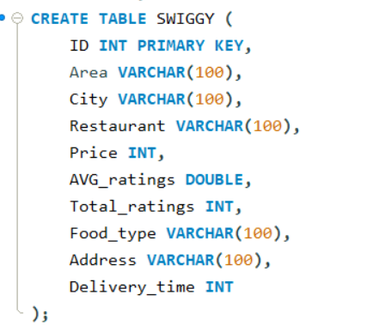
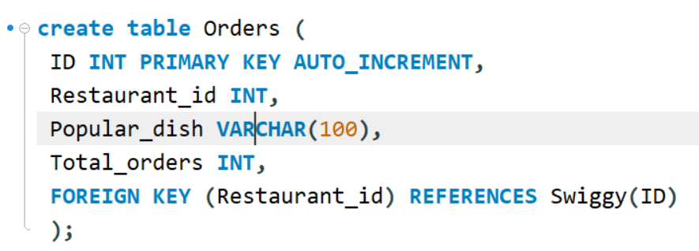
The Swiggy table stores restaurant information such as ID, area, city, name, price, average ratings, total ratings, food type, address, and delivery time.
The Orders table manages order details, including a unique ID, associated restaurant ID (foreign key referencing the Swiggy table), popular dishes, and total orders.
These tables work together to efficiently link orders to restaurants, track popular dishes, and manage delivery-related data in the food delivery system.
Click to view Swiggy Table
Click to view Orders Table

Slide 5

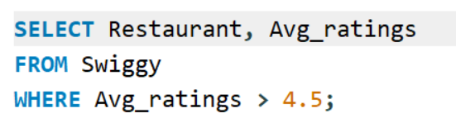


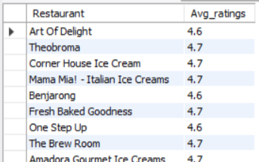
Analysis of High-Rated Restaurants
The objective of the SQL query in the image is to identify all restaurants with an average customer rating greater than 4.5. This helps in pinpointing the best-performing restaurants based on customer feedback.
To view full result, Click here

Slide 6
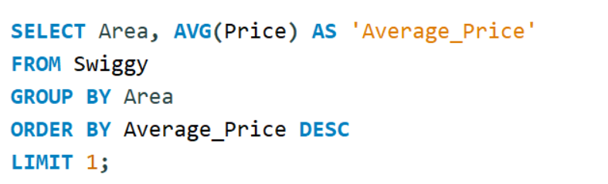

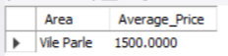
Finding the Area with the Highest Average Price
The SQL query identifies the area with the highest average price for restaurant orders by calculating the average price of orders grouped by area. It sorts the results in descending order of average price and limits the output to a single result. The analysis revealed that Vile Parle has the highest average price of ₹1500, suggesting it represents a premium market segment.
Insights
Vile Parle appears to be a premium area where restaurant orders are more expensive than in other locations.
This insight could guide business strategies, such as targeting premium restaurants in this area or offering exclusive deals.
Use Case:
Launch premium offerings or exclusive deals for high-end restaurants in this area.
Expand partnerships with fine-dining establishments or upscale delivery options.
Position Swiggy as the go-to platform for high-quality dining in affluent areas.

Slide 7
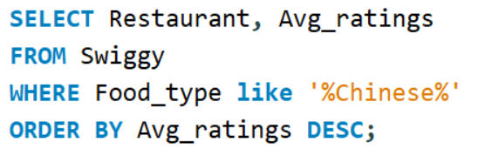
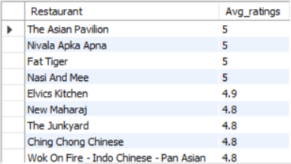
Analyzing Top-Rated Chinese Restaurants
The SQL query retrieves the names and average ratings of restaurants from the Swiggy table that serve Chinese cuisine. It filters the data using the LIKE operator to match any food type containing the word "Chinese" and sorts the results in descending order based on average ratings, ensuring that the highest-rated restaurants appear first. This query is designed to help identify the top-rated Chinese restaurants on the platform.
Insights:
Identifies top-rated Chinese restaurants on Swiggy with ratings from 2.0 to 5.0.
Highlights strong competition and high customer satisfaction in this category.
Restaurants like The Asian Pavilion and Nivala Apka Apna stand out with perfect ratings.
Use Case:
Helps customers find the best-rated Chinese restaurants quickly.
Restaurants with high ratings could be promoted in Swiggy campaigns, while those absent from the list can be encouraged to improve their offerings or service quality.
To view full result, Click here

Slide 8
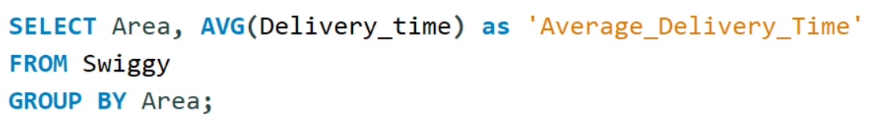
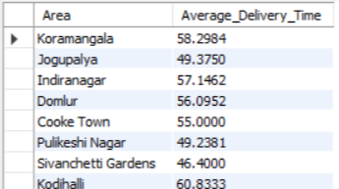
Analyzing Average Delivery Time by Area on Swiggy
The query selects the Area and computes the average delivery time (AVG(Delivery_time)) for each area in the dataset. It uses the GROUP BY clause to group the results by Area, ensuring that the average delivery time is calculated separately for each distinct area.
Insights:
The output shows the average delivery time for each area. For example, Koramangala has the highest average delivery time of 58.2984 minutes.
We can use the ORDER BY clause to identify areas with the fastest and slowest average delivery times.
Variations in delivery times could indicate differences in traffic, restaurant density, or operational efficiency across areas.
Use Case:
Operational Optimization: Swiggy can use this data to improve delivery efficiency in high-delay areas.
Resource Allocation: Swiggy can allocate more delivery agents or optimize routes in areas with higher average delivery times, such as Koramangala.
To view full result, Click here

Slide 9
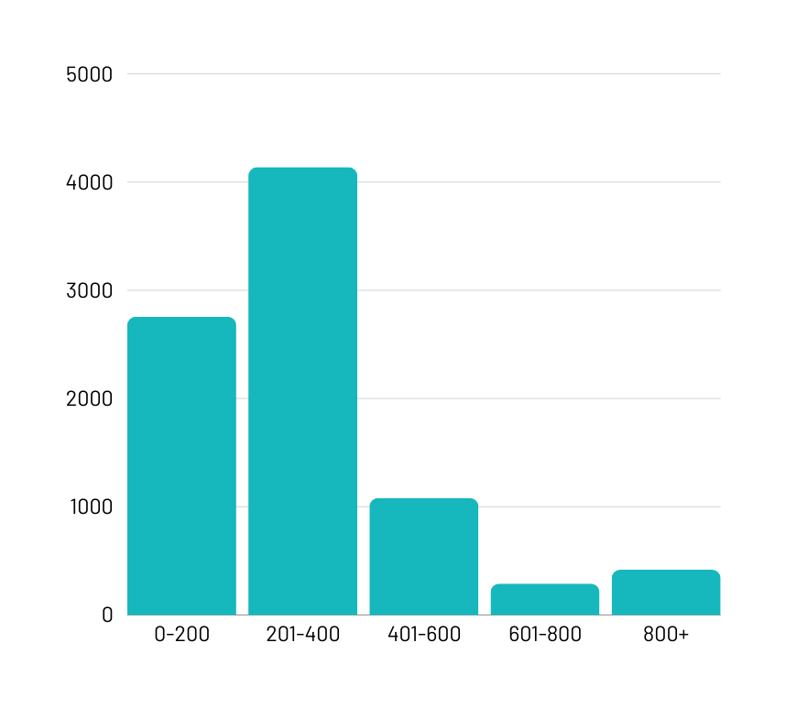

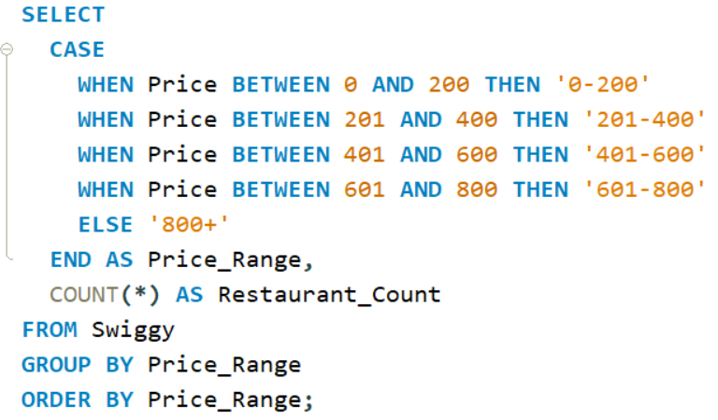
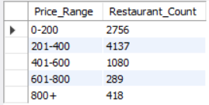


Restaurant Count Analysis Across Price Ranges
The SQL query categorizes restaurants from the swiggy table using CASE expression into price ranges (0-200, 201-400, 401-600, 601-800, 800+) and counts the number of restaurants in each range. The output reveals that the most common price range is 201-400 with 4,137 restaurants, followed by 0-200 with 2,756. High-end options (800+) account for 418 restaurants, while the 601-800 range has the fewest at 289.
Highlights

Slide 10

Key Insights:
The 201-400 price range dominates with 4,137 restaurants, followed by the budget-friendly 0-200 range with 2,756.
High-end restaurants (800+) account for just 418, while mid-tier (601-800) has the fewest with 289.
Over 60% of restaurants fall in the price ranges of 0-400, indicating a significant focus on affordability.
Highlight:
Restaurants in the 201-400 range outnumber those in the 601-800 range by over 14 times, highlighting a gap in mid-tier options.
Recommendations:
Customer Focus: Design promotions or discounts targeting the highly competitive 201-400 range to attract more customers.
Market Gaps: Focus on onboarding more restaurants in the 601-800 range to fill the mid-tier gap.
High-End Appeal: Enhance visibility for premium (800+) options to capture affluent customers.

Slide 11
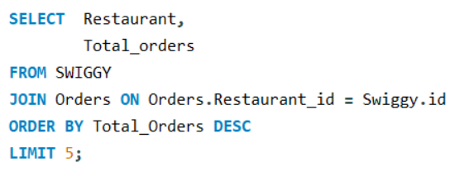
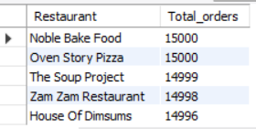
Top 5 Most-Ordered Restaurants on Swiggy
The query retrieves the top 5 restaurants with the highest total orders from the SWIGGY and Orders tables by performing a join on Restaurant_id. Results are sorted in descending order by Total_orders, with Noble Bake Food and Oven Story Pizza leading at 15,000 orders each.
Insights:
Noble Bake Food and Oven Story Pizza lead the list with 15,000 orders each, showcasing their high popularity among users.
These top-performing restaurants likely have a combination of efficient service, popular menu offerings, and strong customer loyalty driving high order volumes.
Use Case:
Operational Excellence: Swiggy can analyze the practices of these top-performing restaurants (menu selection, pricing, delivery efficiency) to replicate success across other restaurants.
Data-Driven Partnerships: Highlight these restaurants in campaigns or app banners to capitalize on their popularity and enhance user engagement.
Data is for illustrative purposes only and may not reflect actual trends, as Total_orders were manually assigned for demonstration.

Slide 12

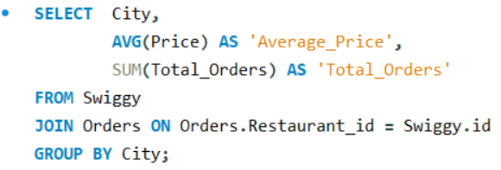
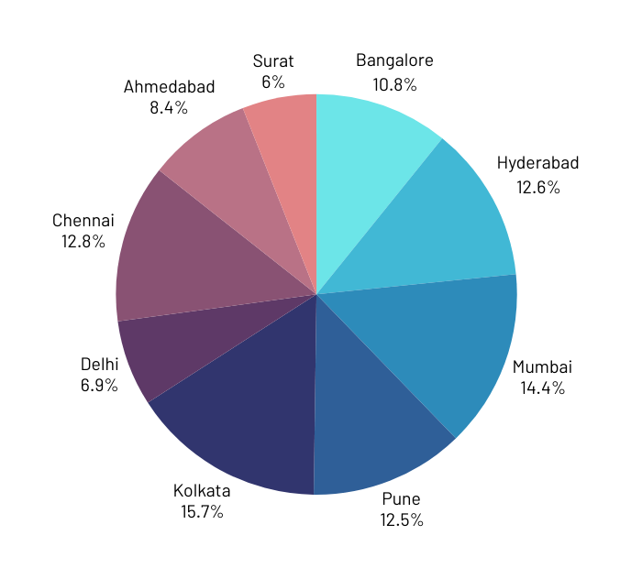
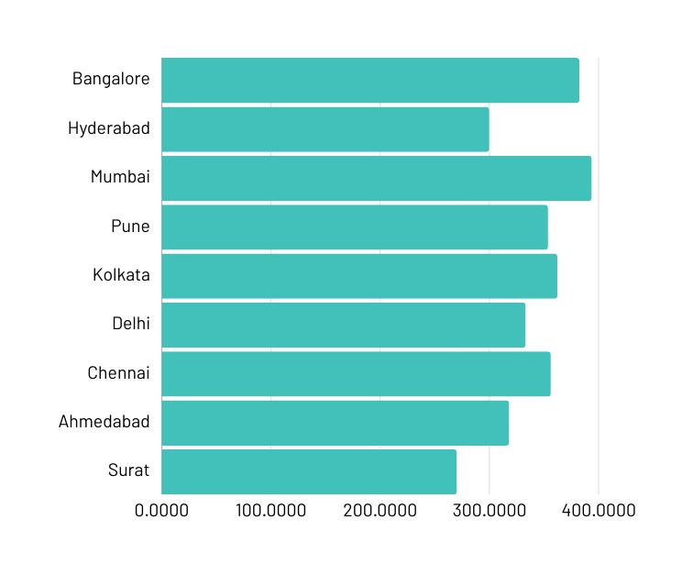
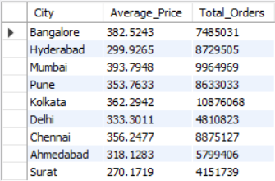
City-Wise Analysis of Pricing and Order Volumes on Swiggy
This updated query calculates the average price (AVG(Price)) and total orders (SUM(Total_Orders) grouped by city by joining the Swiggy and Orders tables. The results show Mumbai has the highest average price (393.79), while Kolkata leads with the most total orders (10,876,068). The data spans multiple cities, revealing key trends in pricing and order volume.
Total_orders
Average_price
Highlights

Slide 13

Insights:
Kolkata: Highest Total Orders.
Mumbai: Highest Average Price.
Surat: Lowest Average Price (₹270.17).
Pune and Chennai balance affordability (₹350–₹360) and high order volumes.
Recommendations
Marketing Campaigns:
High-order cities: Retain customers with loyalty programs.
Low-order cities: Attract customers with targeted discounts.
Price Optimization:
Analyse customer behaviour for cities with low order volumes and tweak pricing strategies accordingly.
Expand Partnerships:
Collaborate with local and premium restaurants for city-specific needs.
Use Cases
Business Growth:
Boost marketing in top-performing cities (e.g., Kolkata, Hyderabad).
Launch discount campaigns in cities with lower order volumes (e.g., Surat, Ahmedabad).
Resource Optimization:
Allocate delivery personnel and inventory based on total order volumes.
Pricing Strategy:
Leverage insights on average prices to design city-specific offers.
Restaurant Partnerships:
Partner with premium restaurants in cities with high average prices like Mumbai.
Encourage affordable dining in cities like Surat to increase orders.

Slide 14
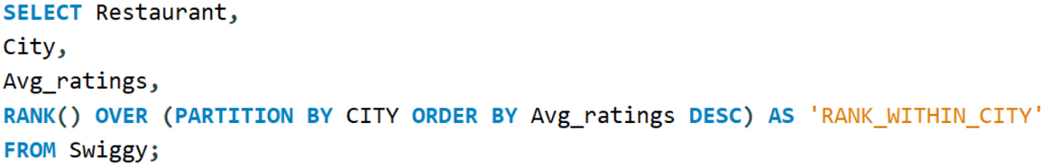

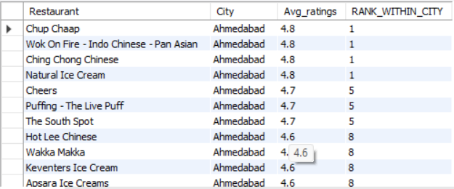
Restaurant Rankings and Ratings Across Cities
The SQL query partitions restaurant data by city and assigns a rank to each restaurant based on its average rating within that city. The result allows identification of the top-rated restaurants per city, enabling businesses or users to prioritize dining options. Ties in ratings share the same rank, ensuring an unbiased ranking system.
Insights:
Top Performers: Restaurants like "Chup Chaap," "Wok On Fire," and "Ching Chong Chinese" in Ahmedabad share the highest average rating of 4.8 and rank first within the city.
Drop in Ratings: There is a noticeable drop from 4.8 to 4.7 (rank 5) and then to 4.6 (rank 8), showing a significant cutoff in customer perception among the top-rated and other restaurants.
City-Specific Insights: This ranking is city-specific, ensuring that the ratings reflect local customer preferences, which can guide businesses in competitive improvements.
Use Case
Customer Recommendations: Suggesting the top-rated restaurants to users based on their location.
Promotions: Highlighting the best-performing restaurants for marketing campaigns or featured listings.
Strategic Partnerships: Prioritizing collaboration with highly rated restaurants.
To view full result, Click here

Slide 15
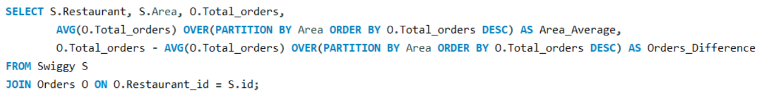
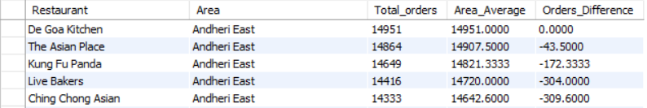
Restaurant Performance Against Area Averages in Total Orders
The SQL query analyzes restaurant performance by calculating the average total orders (Area_Average) within each area and the deviation of each restaurant's total orders from this average (Orders_Difference). Using window functions, it partitions data by area and ranks restaurants based on their total orders. The output showcases how each restaurant's total orders compare to the average for their area, providing insights into which restaurants perform above or below the local average, helping identify top and underperforming outlets.
Recommendation:
For Underperforming Restaurants: Focus on targeted marketing campaigns, menu optimization, or customer engagement to close the gap.
For Top Performers: Reinforce strengths through loyalty programs or enhanced visibility on platforms.
Use Case: Analysing total orders of restaurants in a specific area to compute area averages and the difference in orders compared to the area's average.
To view full result, Click here

Slide 16
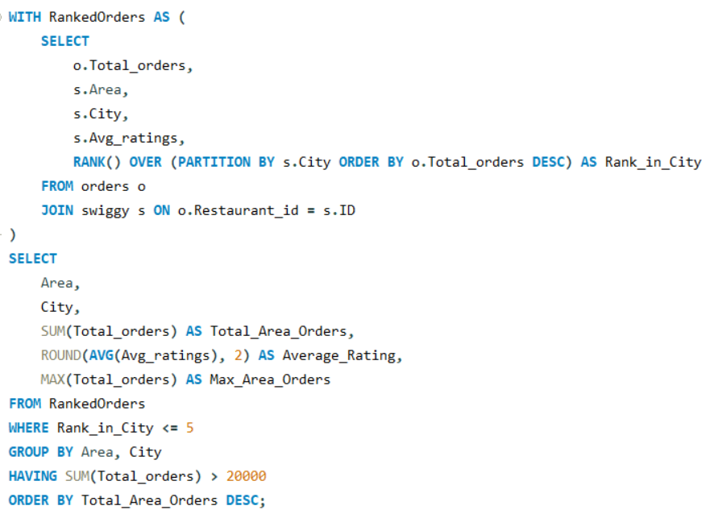
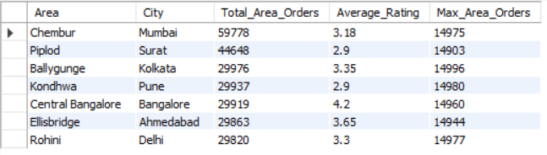
Top Restaurants and High-Demand Areas by City
This query utilizes a WITH clause to define a temporary dataset where restaurants are ranked using the RANK window function. It filters the top 5 per city, calculates SUM, MAX, and AVG of orders and ratings, groups data by area and city, and applies a HAVING condition for areas with over 20000 orders, and sorts results by total demand.
Highlights

Slide 17
Insights
By limiting the analysis to the top 5 restaurants (Rank_in_City <= 5), the query focuses on the best-performing restaurants, eliminating noise from underperforming establishments.
HAVING SUM(Total_orders) > 20000 filters for areas with significant revenue potential. This highlights regions that contribute meaningfully to overall revenue.
Areas with a high sum of orders (SUM(Total_orders)) and high ratings are opportunities for further investment (e.g., marketing, logistics improvements).
Use Cases:
Analyse restaurant data to understand which areas and cities are contributing the most to order volumes.
Identify low-performing areas or cities (those not meeting the HAVING condition) to target for promotional offers or service improvements.
Performance Trends: Analyse which cities or areas have the highest average ratings and total orders, helping prioritize delivery expansions or promotional campaigns.
Areas with high total orders and high average ratings are prime candidates for opening new franchises or expanding existing services.

Slide 18
Conclusion
The analysis uncovered key trends in restaurant performance, pricing, delivery efficiency, and customer preferences.
These insights can guide Swiggy in enhancing user experience, optimizing operations, and driving growth.
Future Scope
Real-Time Data Integration: Incorporate live data for dynamic analysis.
Customer Feedback: Analyse reviews and ratings to refine service quality.
Advanced Analytics: Use machine learning to predict demand for dishes, areas, or price categories.
Scalability: Extend the analysis to other regions or platforms.

Slide 19


Thank
You

